Slide 1

Recycle plastic waste
Presented by Bùi Hương Linh
Student ID: GBH200662
Class: GCH1002
Tutor: Đỗ Tiến Thành
Notes:
Hello teacher and everyone.
In the following, I will present a presentation on recycling plastic waste.

Slide 2
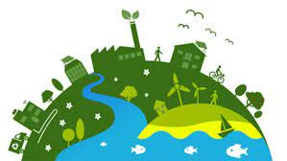
TABLE OF CONTENTS
1. Introduction
2. Overview of system
3. Research tools and techniques
4. The results of research
5. Conclusion
Notes:
The content of my presentation includes

Slide 3

1.Introduction
Our project will minimize environmental pollution by recycling plastic waste.
Notes:
The first is the introduction
In the following, I will present an overview of my project.

Slide 4
2. Overview of system
Scope | Purpose
The "Green Environment" project is a plastic waste recycling application that contributes to environmental protection. This project will be implemented in about 6 months with an estimated budget of $116800, including project planning, project design, development and testing, advertising, maintenance. | Recycling plastic waste contributes to less pollution and cleaner air. Help people know how to sort plastic waste. Save money on buying new appliances, protect your personal finances Reduce the amount of waste that goes outside each day.
Notes:
The "Green Environment" project is a plastic waste recycling application that contributes to environmental protection. This project will be implemented in about 6 months with an estimated budget of $116800 (and ết hang đờ rớt đô lờ), including project planning, project design, development and testing, advertising, maintenance.
Reduce the amount of waste that goes outside each day.

Slide 5
3. Research tools and techniques
Hypothesis | Interview
By providing an easy-to-use platform for recycling plastic waste, more people will be motivated to participate in recycling efforts, leading to a reduction in plastic pollution. | How do you believe that the "Green Environment" platform will motivate more people to recycle?
 | What steps have you taken to ensure that the platform is easy to use for all users?
Through partnerships with other organizations and companies, "Green Environment" can expand its reach and impact, raising awareness about plastic waste and promoting sustainable behavior. | How will partnerships with other organizations and companies enhance the impact of the "Green Environment" platform?
 | What criteria will you use to select potential partners?
By reinvesting 100% of profits into society, "Green Environment" will gain the trust and support of customers who prioritize social and environmental responsibility. | What inspired you to reinvest 100% of profits from the "Green Environment" platform back into society?
 | How do you believe this will impact customer trust and support for the platform?

Slide 6
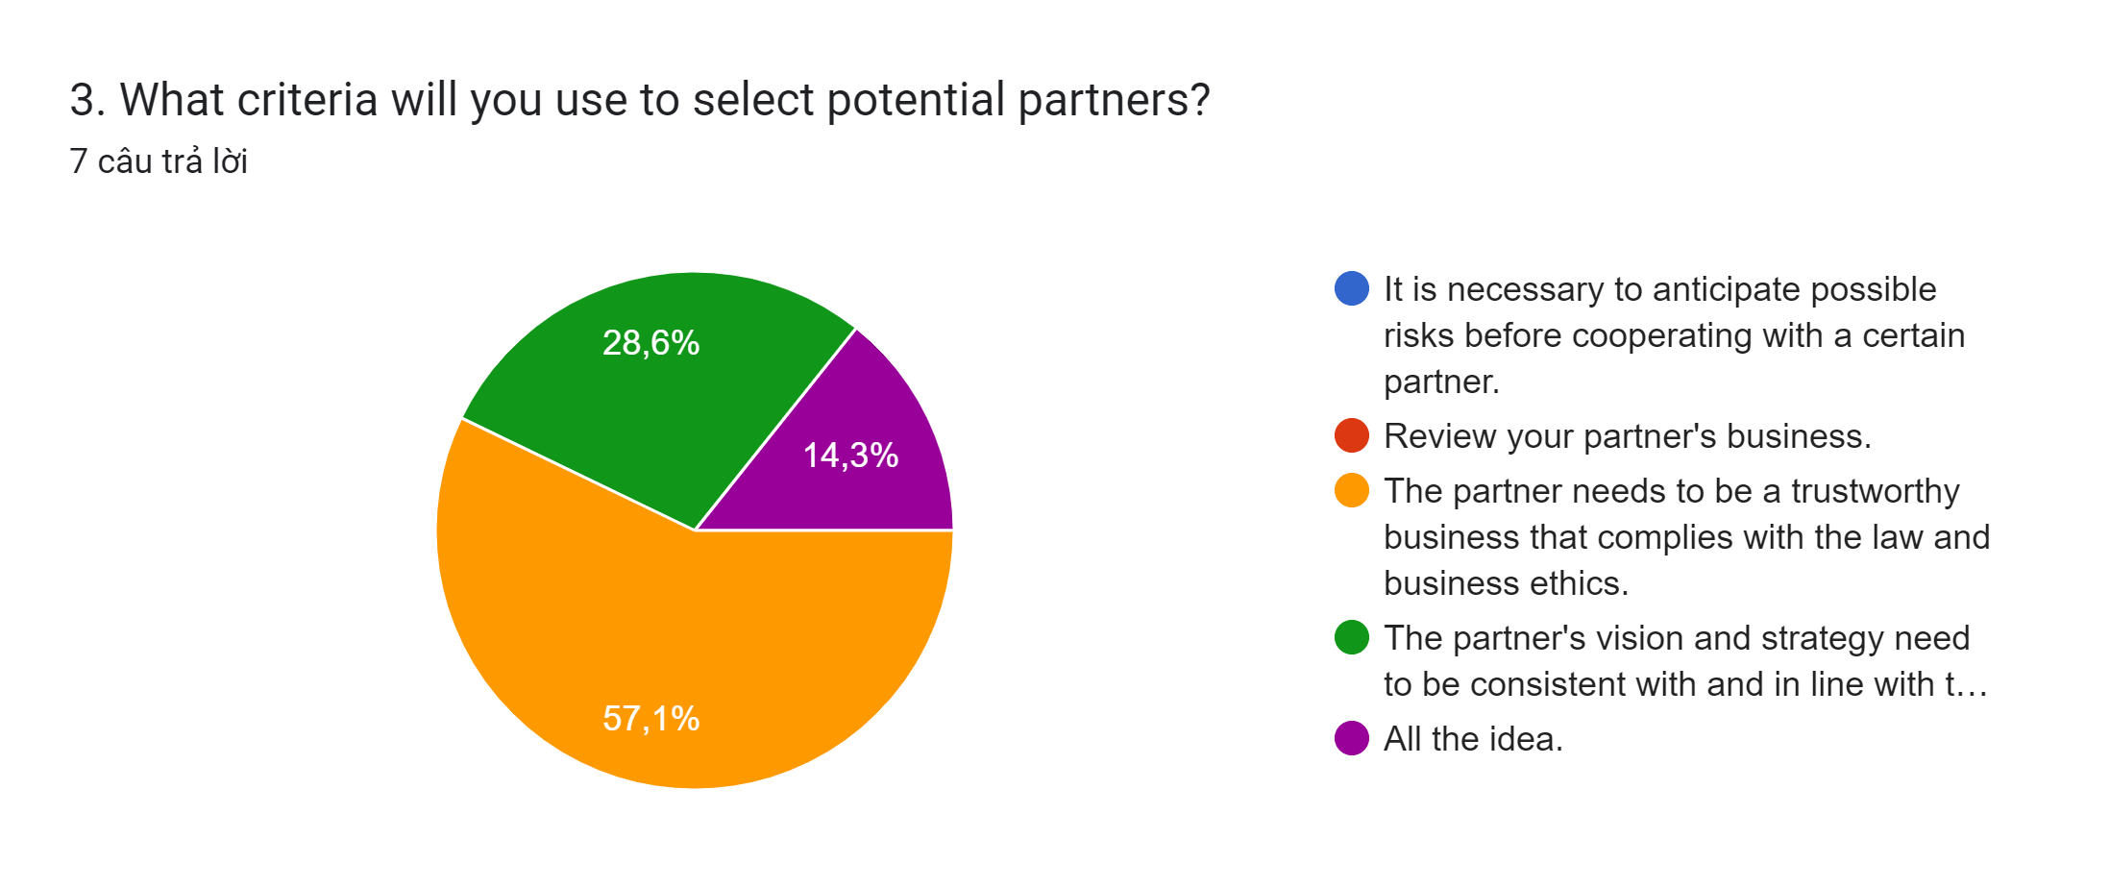
4. The results of research
Hypothesis 1: Through partnerships with other organizations and companies, "Green Environment" can expand its reach and impact, raising awareness about plastic waste and promoting sustainable behavior.
Notes:
Looking at the chart shows that people are very interested in choosing potential(bơ ten sồ) partners to cooperate(câu ô pơ rết) with. According to statistics, partners need to be reliable, law-abiding and ethical businesses, accounting for 57.1% ( phíp ty seven phoi one bơ sen). Thus, to find a partner needs a lot of factors.

Slide 7
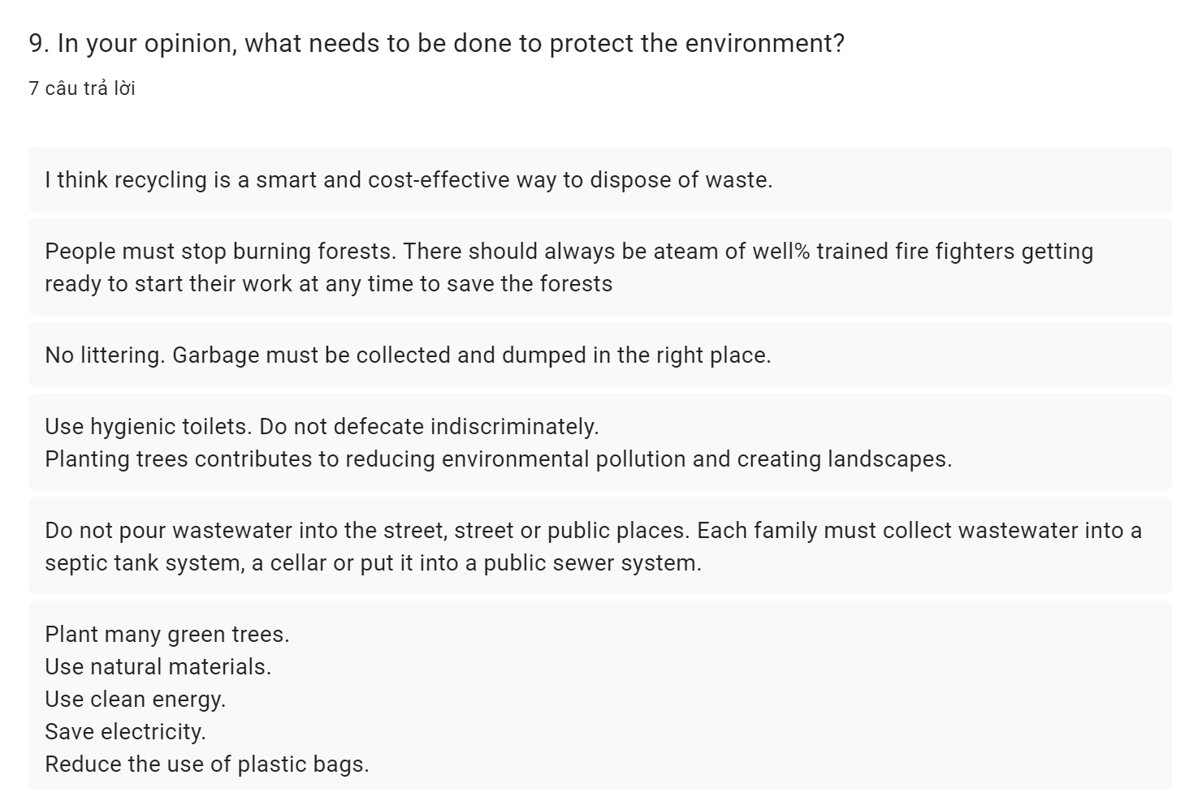
4. The results of research
Notes:
Through the question, I think everyone knows how to protect the environment.
To protect the environment
Do not pour wastewater into the street, street or public places. Each family must collect wastewater into a septic tank system, a cellar or put it into a public sewer system.
I think recycling is a smart and cost-effective way to dispose of waste.
People must stop burning forests. There should always be ateam of well% trained fire fighters getting ready to start their work at any time to save the forests
Plant many green trees.
Use natural materials.
Use clean energy.
Save electricity.
Reduce the use of plastic bags.

Slide 8
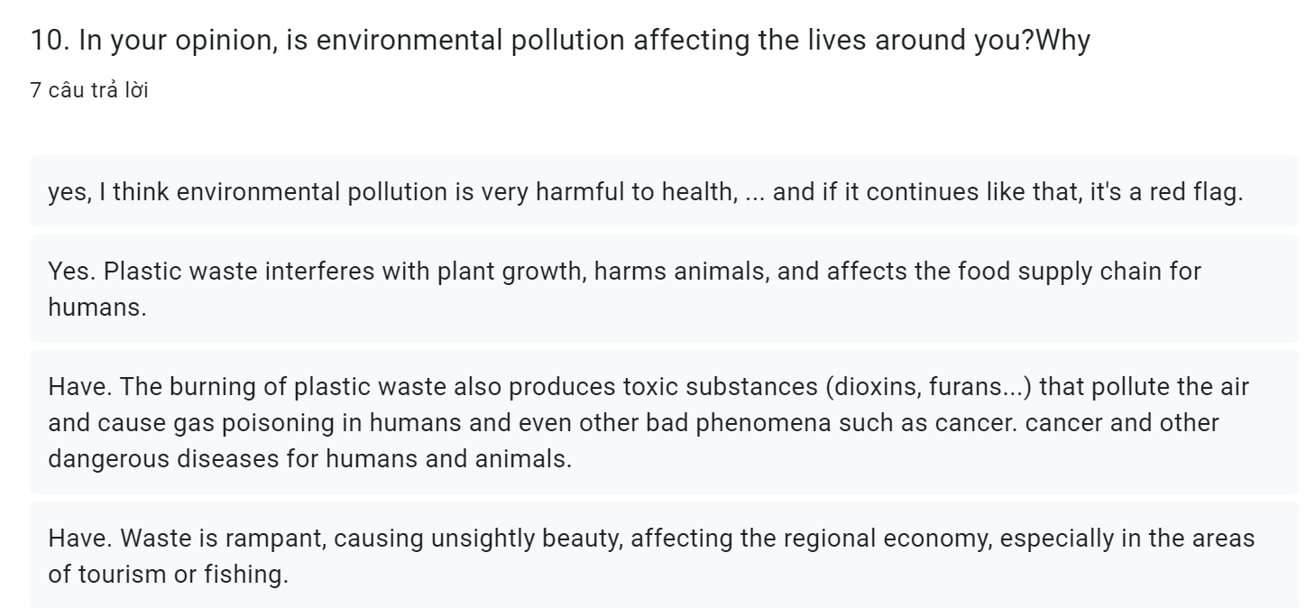
4. The results of research
Notes:
Through the question, ….. everyone agrees that environmental pollution affects the surrounding life.
Yes. The burning of plastic waste also produces toxic substances (dioxins, furans...) that pollute the air and cause gas poisoning in humans and even other bad phenomena such as cancer. cancer and other dangerous diseases for humans and animals.
Yes. Plastic waste is difficult to decompose, hindering the growth of trees and plants.
Yes. It threatens human health, pollutes water sources, unbalances ecosystems and affects the development of animals, plants and organisms.

Slide 9
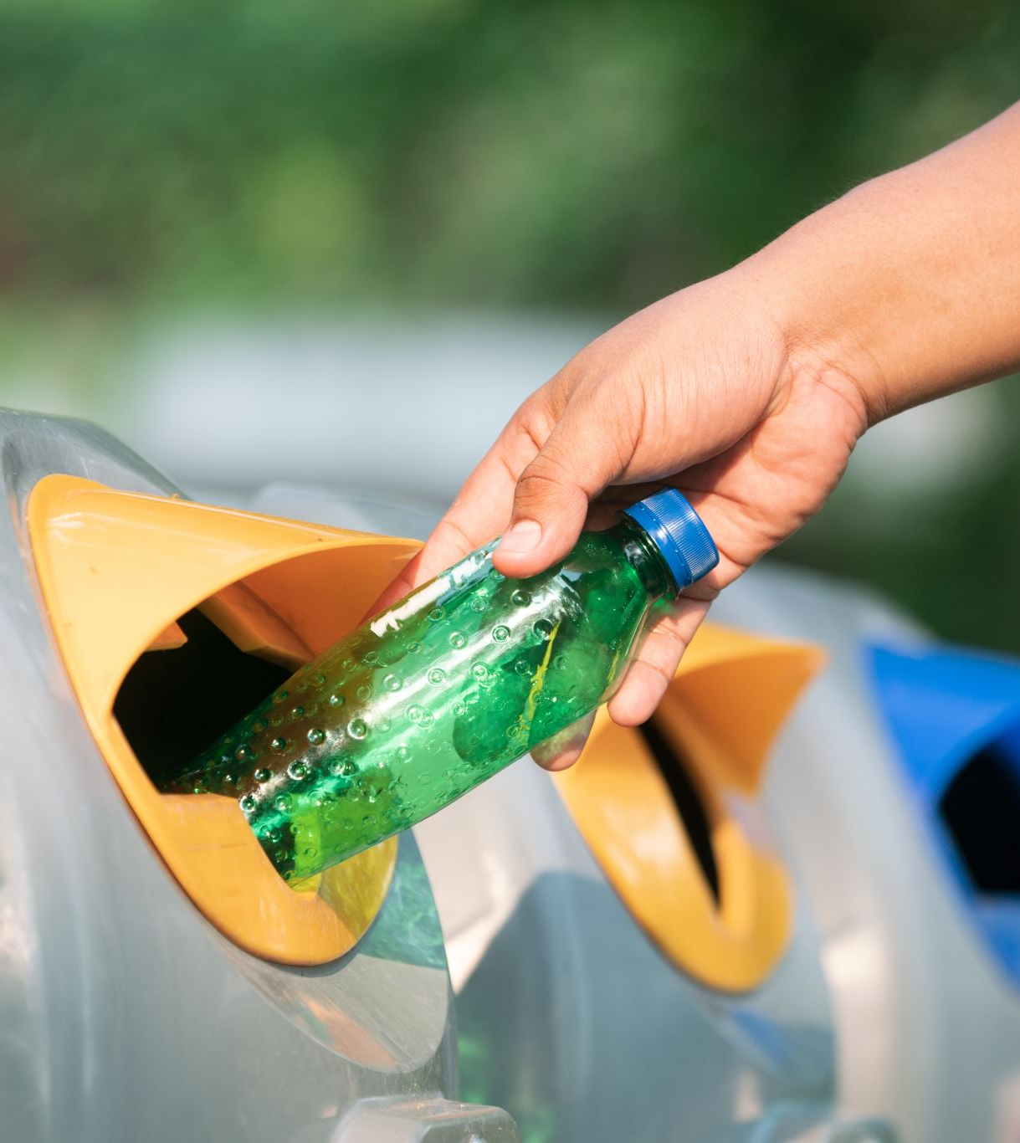
Conclusion
In conclusion, our project aims to recycle to address the growing concern about plastic waste. Contribute to reducing plastic waste and protecting everyone's health.
Notes:
Help people know how to sort garbage for recycling, avoid burying in the ground or littering, causing unsightly beauty.

Slide 10
Thank you for listening!

